Slide 1
Machine Learning - 1
Unit 2

Slide 2
Unit 2

Slide 3
Performance Metrics

Slide 4



Performance Metrics
Performance Metrics or Evaluation Metrics in machine learning are used to evaluate a model’s performance.
Evaluating a model is a core part of building an effective machine learning model
Once the ML model is build, we get feedback from metrics, make improvements and continue until you achieve a desirable accuracy.
An important aspect of evaluation metrics is their capability to discriminate among model results.

Slide 5
MSE

Slide 6


MSE
MSE is a performance metrics and is used as a loss function.
Mean Squared Error (MSE) is defined as Mean or Average of the square of the difference between actual and estimated values.
MSE tells you how close a regression line is to a set of points.

Slide 7
MSE
How to calculate MSE
Take the distances from the points to the regression line (these distances are the “errors”)
Square the value
The squaring is necessary to remove any negative signs. It also gives more weight to larger differences.
It’s called the mean squared error as you’re finding the average of a set of errors.
The lower the MSE, the better the prediction will be.

Slide 8
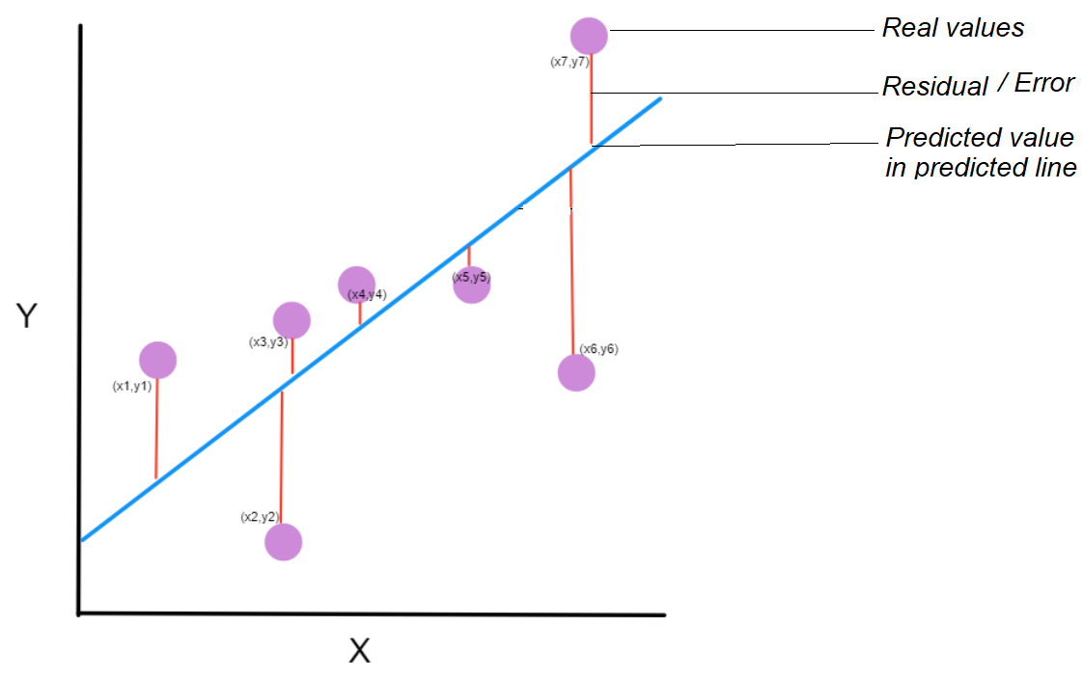
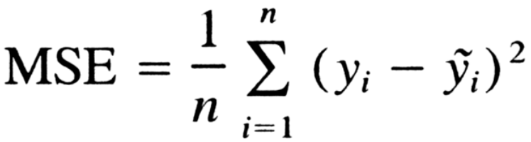
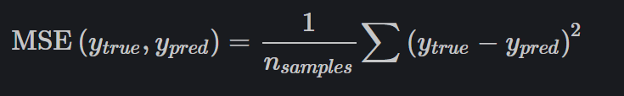
MSE
OR

Slide 9
MSE
How to calculate MSE
Step1: Sigma is the sum of a sequence of numbers, from i=1 to n.
Step 2: For each point, we take the y-coordinate of the point, and the y’-coordinate. The y-coordinate is our purple dot. The y’ point sits on the blue line we created. We subtract the y-coordinate value from the y’-coordinate value, and calculate the square of the result.
Step 3 : The third part is to take the sum of all the (y-y’)² values, and divide it by n, which will give the mean.

Slide 10
Accuracy

Slide 11

Accuracy
Accuracy is defined as the percentage of correct predictions for the test data.
It can be calculated easily by dividing the number of correct predictions by the number of total predictions.

Slide 12
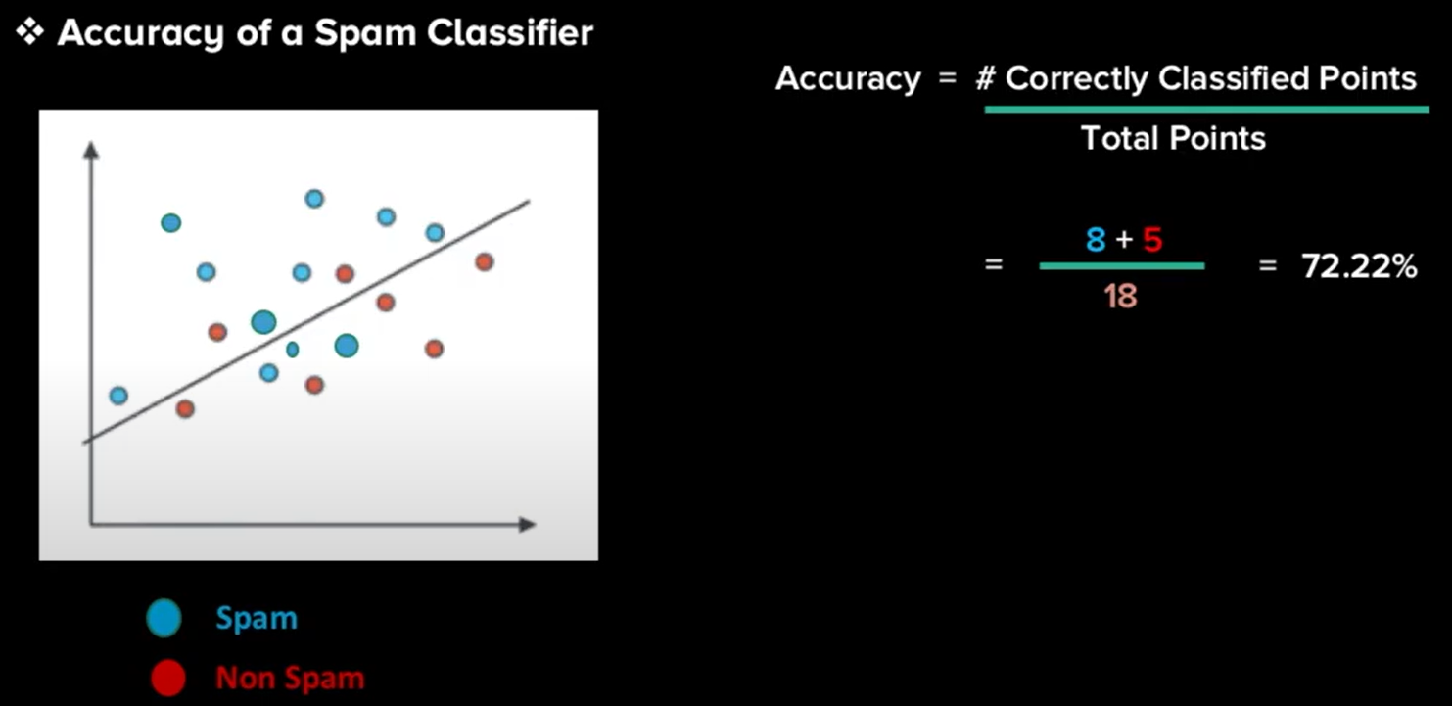
Accuracy
Example : Calculating accuracy of a Spam Classifier

Slide 13
Confusion Matrix

Slide 14
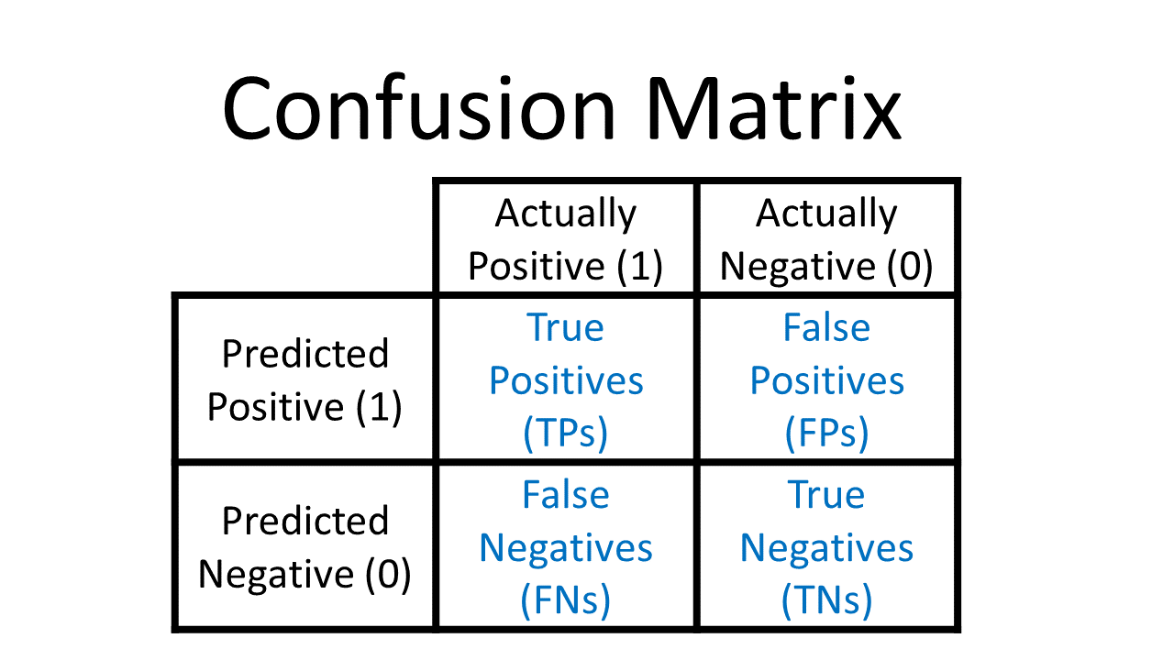
Confusion Matrix
A confusion matrix / error matrix is a table that is used to describe the performance of a classification model on a set of test data for which the true values are known.

Slide 15
Confusion Matrix
True Positives : Correctly predicted positive classes
True Negatives : Correctly predicted negative classes
False Negatives : Incorrectly predicted negative classes
False Positives : Incorrectly predicted positive classes

Slide 16
Confusion Matrix
Example : Heart disease prediction – TP, TN, FN, FP values
True Positives : These are patients that had heart disease and were correctly identified by the algorithm.
True Negatives : These are patients that did not have heart disease and were correctly identified by the algorithm.
False Negatives : These are patients that had heart disease, but the algorithm says they didn't. (type 2 error)
False Positives : These are patients that do not have heart disease, but the algorithm says they do. (type 1 error)

Slide 17
Precision

Slide 18

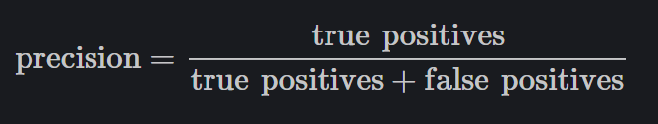
Precision
Precision refers to the percentage of your results which are relevant, among the retrieved.
Precision is also called as ‘positive predicted value’
Precision is defined as the number of true positives divided by the number of true positives plus the number of false positives.

Slide 19
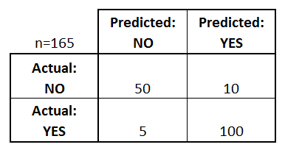
Example :
Precision
Precision = 50 / (50 + 10)
Precision = 83 %

Slide 20
Recall

Slide 21
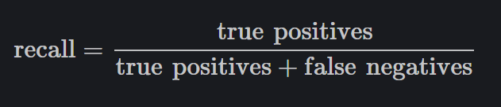
Recall
Recall refers to the percentage of total relevant results correctly classified by your algorithm
Recall is also called as ‘sensitivity’
Recall is defined as the number of true positives divided by the total number of true positives and false negatives.

Slide 22
Example :
Recall
Recall = 50 / (50 + 5)
Recall = 91 %

Slide 23
F-score

Slide 24

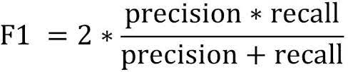
F-score
F-score is a measure of a model's accuracy on a dataset.
F-score is also called as ‘F1-score’
The formula for the standard F1-score is the harmonic mean of the precision and recall.

Slide 25
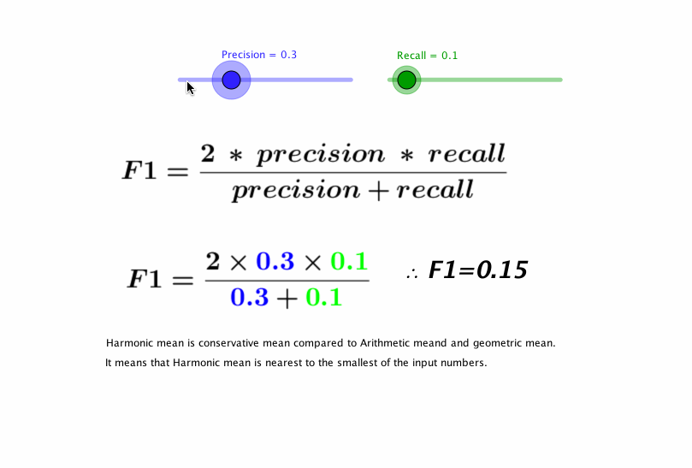
F-score

Slide 26
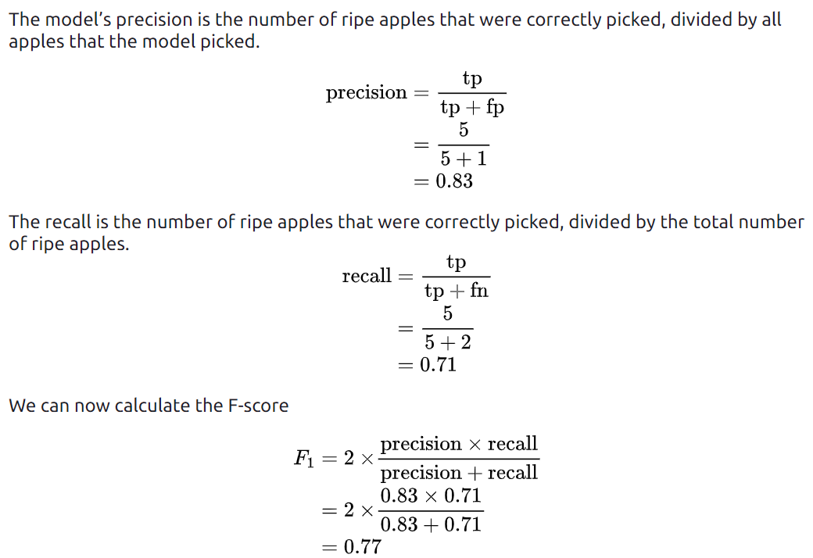
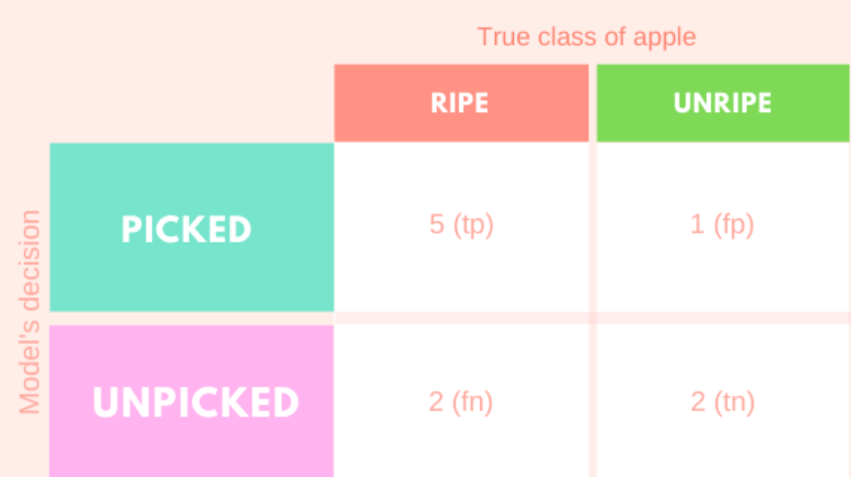
F-score
Example :
True Positive : 5
False Positive : 1
False Negative : 2
True Negative : 2

Slide 27
Sensitivity Vs Specificity
Sensitivity :
Sensitivity of a classifier is the ratio between how much were correctly identified as positive to how much were actually positive.
Sensitivity = TP / FN+TP
Where it is used ?
Places where classification of positives are high priority.
Eg: Recommender system for e- commerse website
Specificity :
Specificity of a classifier is the ratio between how much were correctly classified as negative to how much was actually negative.
Specificity = TN/FP+TN
Where it is used?
Places where classification of negatives are high priority.
Eg: Diagnosing for a health condition before treatment.

Slide 28
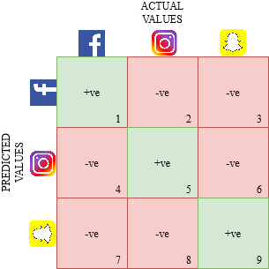
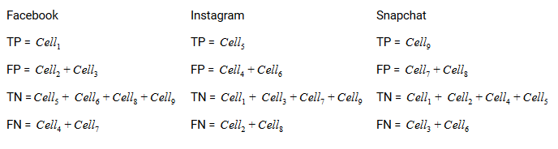
Multi Class Classification

Slide 29
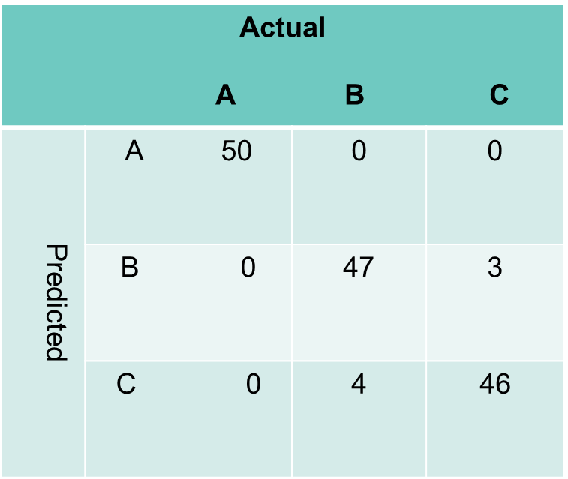
Excercise

Slide 30
Linear Regression with multiple variables

Slide 31
Linear Regression
Regression is used to determine the relationship between one dependent variable (y) and a series of independent variables (X).
Linear Regression is used to determine the linear relationship between one dependent variable (y) and one independent variable (X).
Multiple Regression (Linear Regression with multiple variables) is used to determine the linear relationship between one dependent variable (y) and a series of independent variables (X1, X2, X3,…).

Slide 32
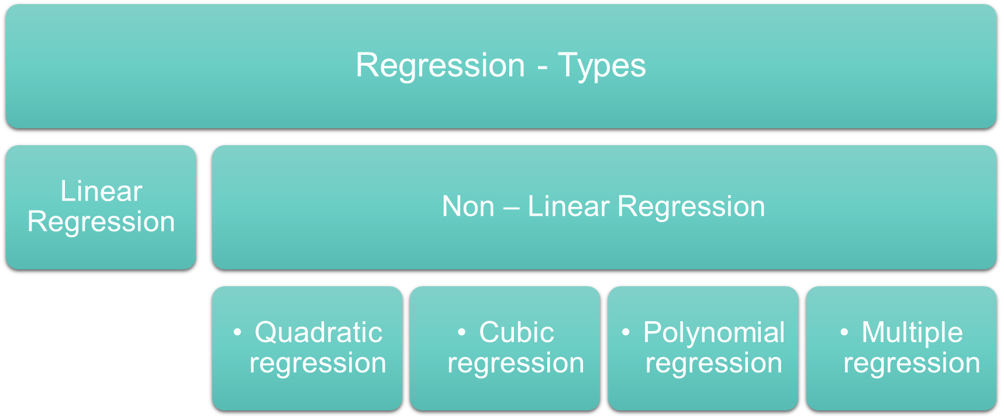
Regression and its types

Slide 33
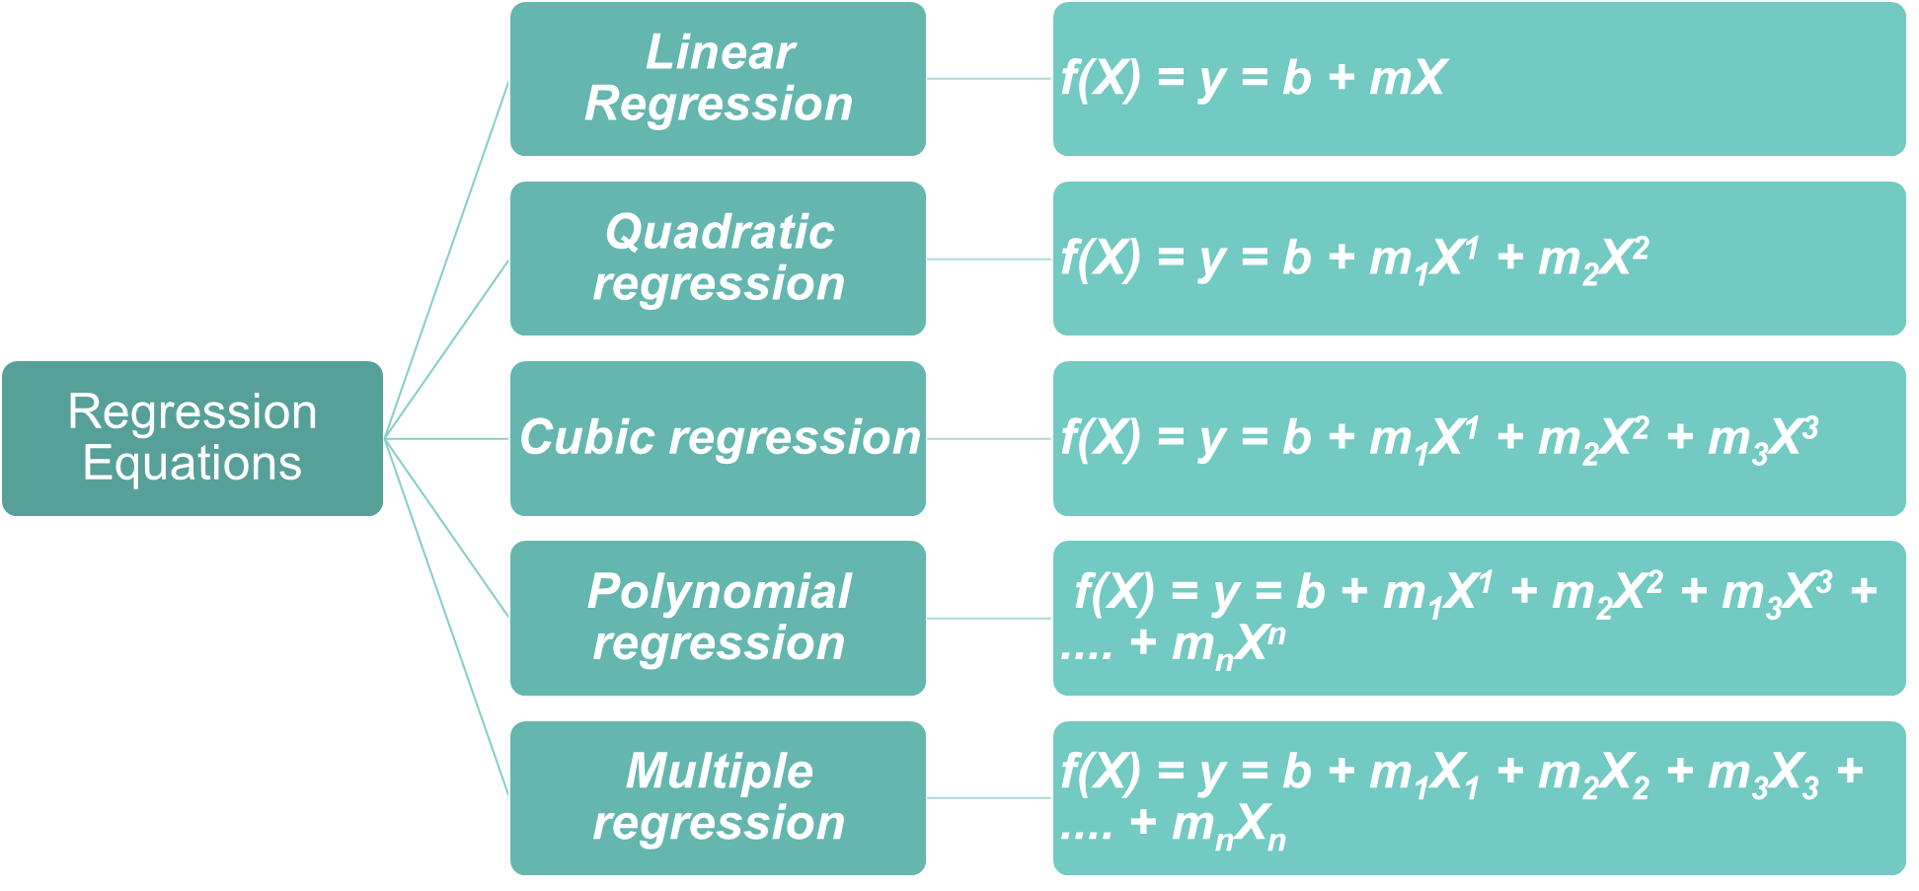
Regression Equations

Slide 34
Linear Regression
Linear Regression : Formula
Linear Regression
f(X) = y = b + mX
f(X) or y : Dependent variable / Target / Output / Predicted variable
b : y-intercept
m : slope
Example:
Predicting house price (y) by considering the number of rooms (X)
X : Independent variable / Input variable

Slide 35

Multiple Regression
Multiple Regression : Formula
Multiple Regression
f(X) = y = b + m₁X₁ + m₂X₂ + m₃X₃ + .... + m_{n}X_{n}
f(X) or y : Dependent variable / Target / Output / Predicted variable
b : y-intercept
m_{1,} m_{2,} … m_{n} : Respective slopes
X¹, X²,…X^{n} : Independent variables / Input variables
Example: Predicting house price (y) by considering the number of rooms (X₁), Locality (X₂), Room size (X₃), Floor (X₄), Age of the building (X₅)

Slide 36
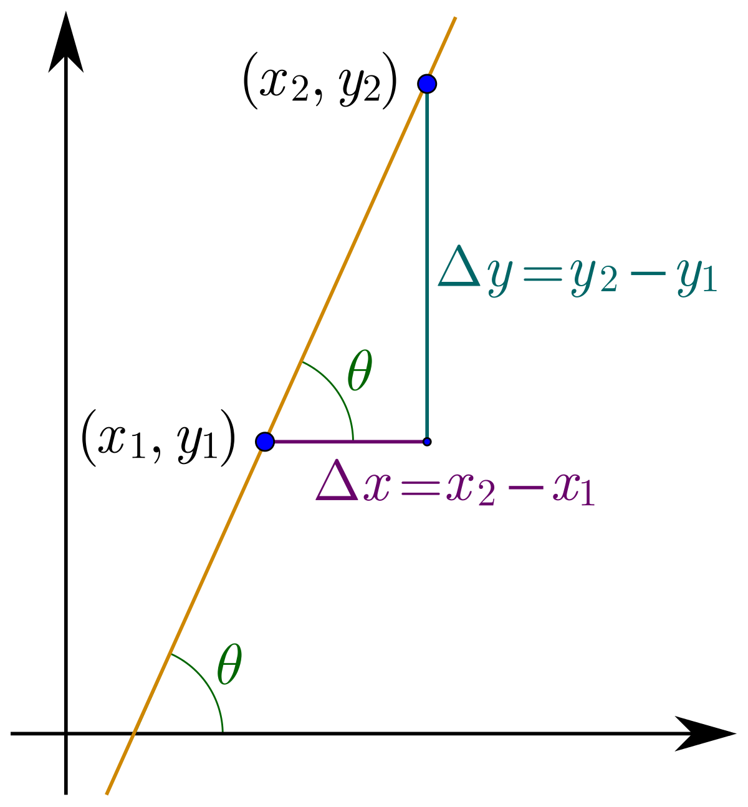
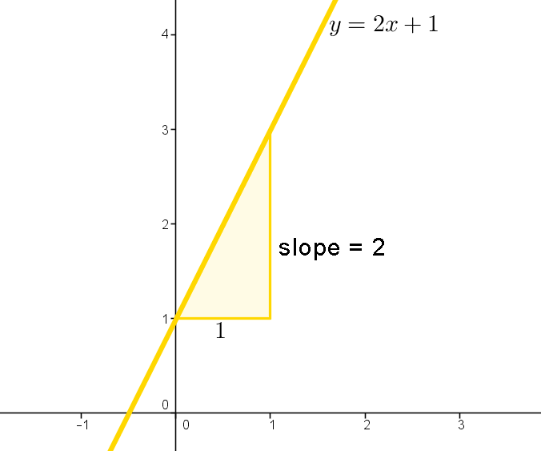
Slope in Linear Regression

Slide 37
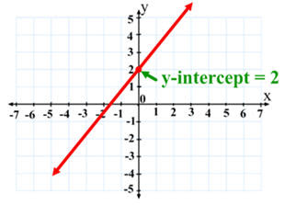
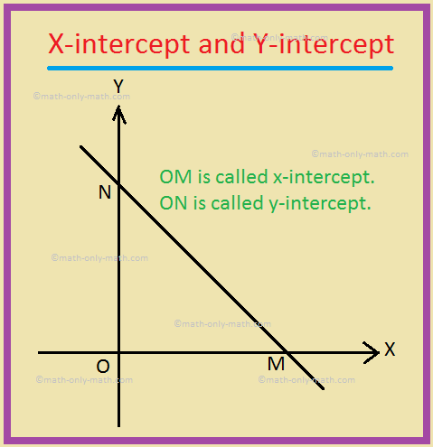
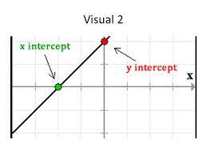
Intercept in Linear Regression

Slide 38
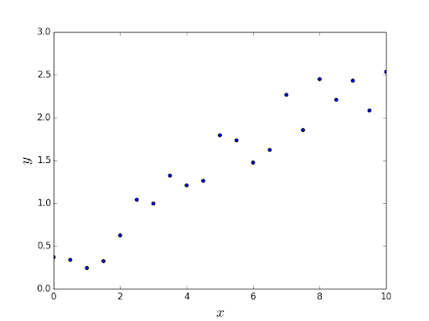
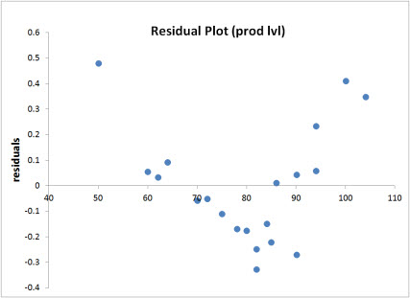
Linear vs Non-linear data points

Slide 39
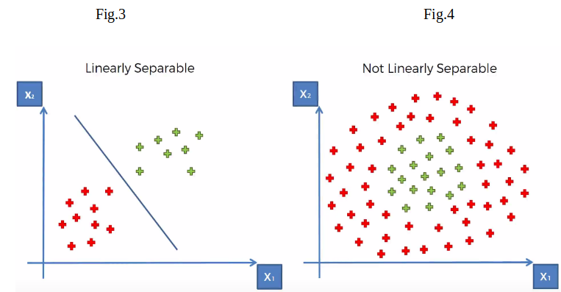
Linear separable vs Linearly non-separable

Slide 40
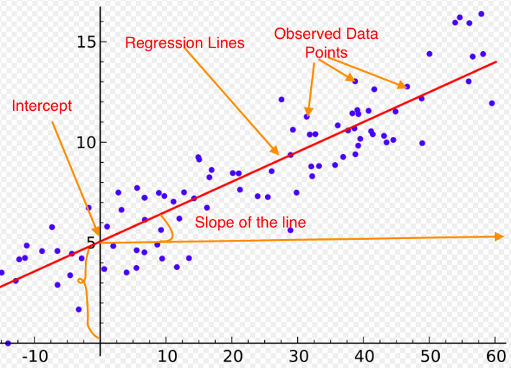
Regression line
A Regression line is a line that best describes the behavior of a set of data. In other words, it's a line that best fits the trend of a given data.

Slide 41
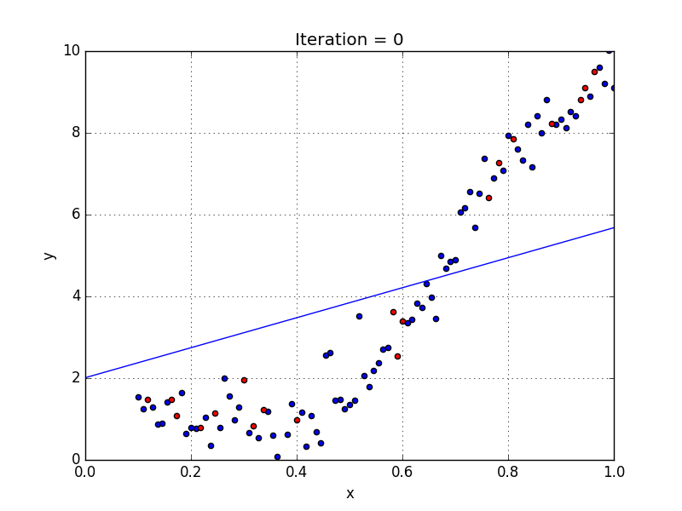
Linear Regression : Line of best fit
Line of best fit refers to a line through a scatter plot of data points that best expresses the relationship between those points.
f(X) = y = b + mX

Slide 42
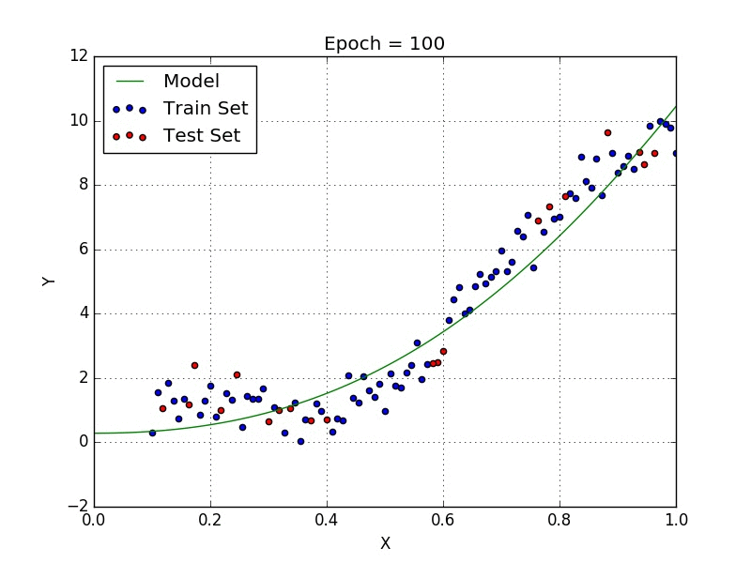
Multiple Regression : Line of best fit
Line of best fit refers to a line through a scatter plot of data points that best expresses the relationship between those points.
f(X) = y = b + m₁X₁ + m₂X₂ + m₃X₃ + .... + m_{n}X_{n}

Slide 43
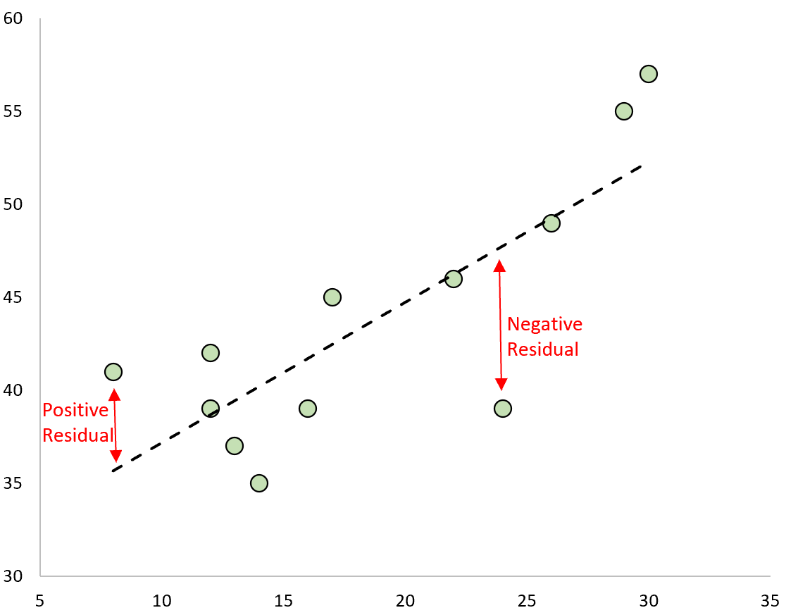
Residual
Residuals are the differences between observed and predicted values of data.
Residuals are also called as errors.

Slide 44
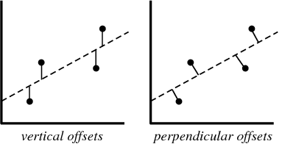
Least Squares for Linear Regression
Least squares is a method in linear regression for fitting a line to the data.
Least squares is used for finding the best-fitting line/curve to a given set of points by minimizing the sum of the squares of the offsets ("the residuals") of the points from the line/curve.

Slide 45
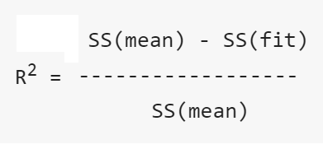
R squared for Linear Regression
R squared : R squared is a goodness of fit measure.
R squared is also called as ‘coefficient of determination’.
R squared can range from 0 to 1.
Greater the R squared value, better the model.
R squared: Formula
SS(fit) : Sum of squares for the residuals around the best fitting line.
SS(mean) : Sum of squares for the residuals around the worst fitting line, the mean of the y-axis values.

Slide 46
P-Value for Linear Regression
P value: A p-value is a measure of the probability that an observed difference could have occurred just by random chance.
P value is used to measure if category A and category B are different in terms of probability.
Example: Consider two categories of drugs, drug A and drug B. If we wanted to measure the probability that drug A and drug B are different then we go for p-value.
Range of P value: It ranges from 0 to 1.
If p-value = 0 --> Both categories are different
If p-value = 1 --> Both categories are same

Slide 47
Logistic Regression

Slide 48
Logistic regression
Logistic Regression: Logistic regression is a very popular machine learning algorithm used for binary classification.
Logistic Regression is a supervised machine learning algorithm and is used for predicting a discrete value (0 or 1).
Example:
If an e-mail is a spam or not
If the picture is a dog or a cat
If the person is a male or a female

Slide 49
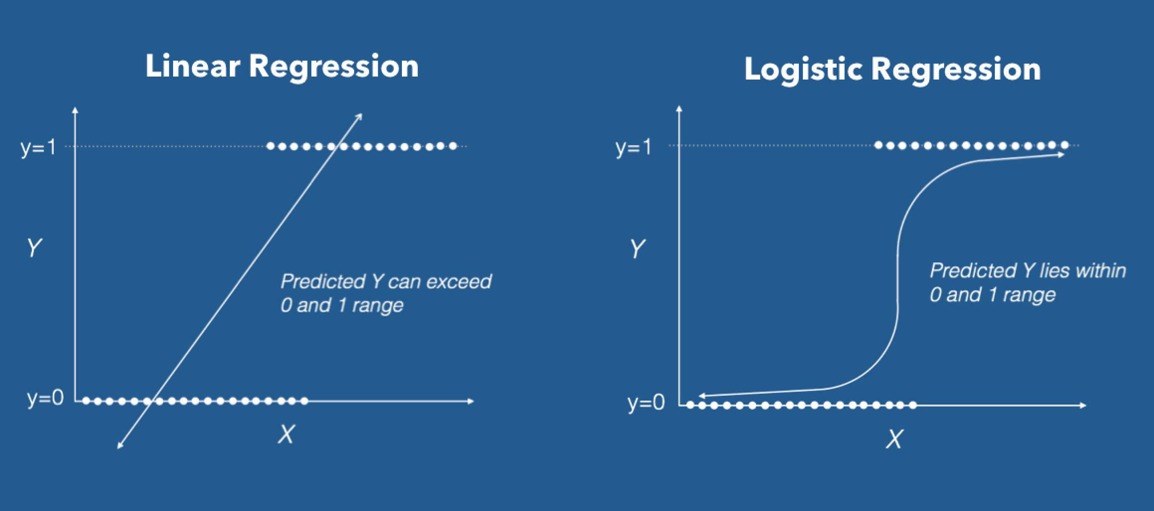
Logistic regression

Slide 50

Steps in Logistic regression
Step 1: Calculate the logistic function / logit function / sigmoid function.
Step 2: Learn the co-efficients / model parameters for a logistic regression.
Step 3: Make the predictions for the model.

Slide 51
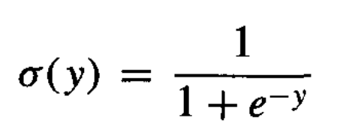
Step 1 in Logistic regression
Step 1: Calculate the logistic function / logit function / sigmoid function.
Logistic function: The logistic function transforms each input variable to a range between 0 and 1.
Values: The smallest negative values remains close to zero and the largest positive values remains close to one

Slide 52
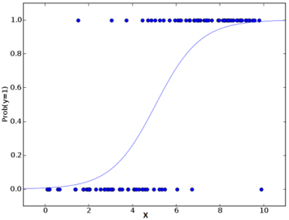
Step 1 in Logistic regression
Logistic function transformation is shown below.
Before applying Logistic function
After applying Logistic function

Slide 53
Threshold in Logistic regression
Threshold: The Threshold or Cut-off represents in a binary classification the probability that the prediction is true.
Threshold represents the tradeoff between false positives and false negatives.
Example: If a person is male or female. Lets consider the threshold value is 0.5. If the threshold value is > 0.5 then the person is a male otherwise female.

Slide 54
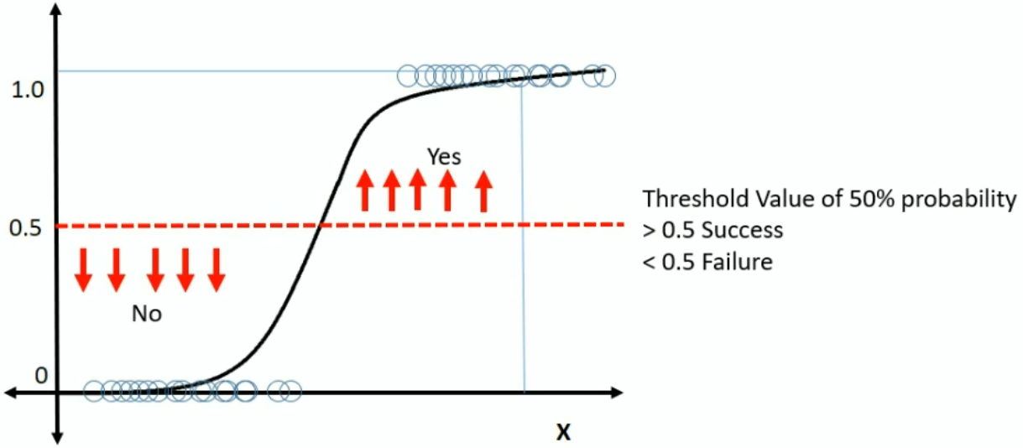
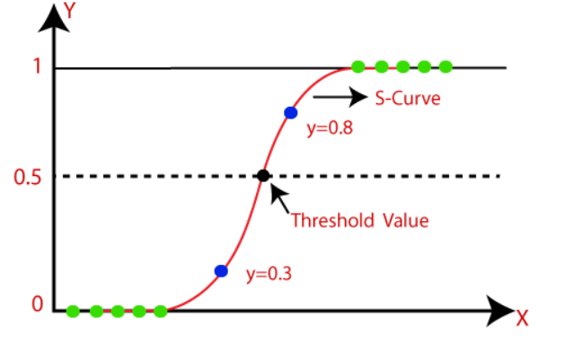
Threshold in Logistic regression

Slide 55
Step 2 in Logistic regression
Step 2: Learn the co-efficients / model parameters for a logistic regression.
1
Prob (y) = ----------------------------------------------
1 + e – (b + m1X1 + m2X2 + m3X3 + .... + mnXn )
Model parameters : These are the parameters in the model that must be determined using the training data set. These are the fitted parameters.
Model parameters here are b, m₁, m₂, m₃, … , m_{n},
Several algorithms are present to calculate model parameters and one popular algorithm is ‘Gradient Descent’

Slide 56

Step 3 in Logistic regression
Step 3: Make the predictions for the model.
Epoch: One round of calculating the predicted value for all the training set using the model parameter is called as an “Epoch”
Many Epochs: In prediction, we go for many epochs.
Point of convergence: We stop evaluating at the point of convergence, which means when two values are almost the same.

Slide 57
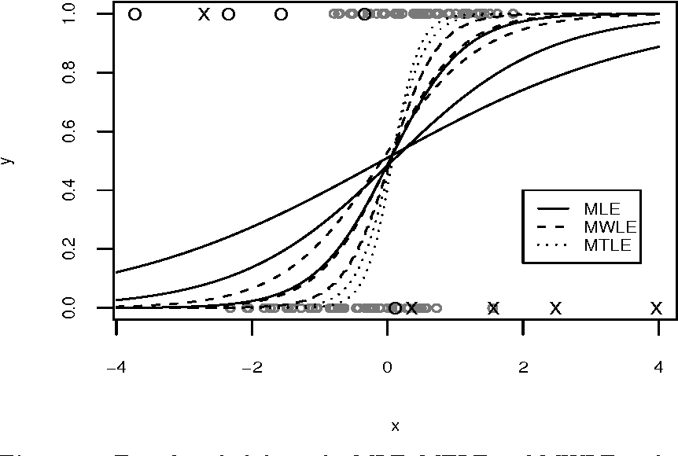
Maximum Likelihood for Logistic Regression
Maximum Likelihood is a method in logistic regression for fitting a curve to the data.
Maximum Likelihood is used for finding the best-fitting curve to a given set of points by minimizing the sum of the squares of the offsets ("the residuals") of the points from the curve.

Slide 58
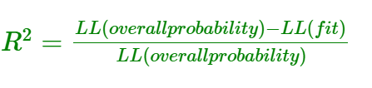
R squared for Logistic Regression
R squared : R squared is a goodness of fit measure.
R squared is also called as ‘coefficient of determination’.
R squared can range from 0 to 1.
Greater the R squared value, better the model.
R squared: Formula
LL(fit) :Log-likelihood of the fitted line - Measure of a good fit.
LL(overall probability) :Log-likelihood of the fitted line - Measure of a bad fit.

Slide 59
P-Value for Logistic Regression
P value: A p-value is a measure of the probability that an observed difference could have occurred just by random chance.
Range of P value
CASE 1: p-value = 1 (Bad fit)
When LL(fit) = LL(overall probability) = 0. The area under the curve from 0 to infinity = 1. So, p-value = 1.
CASE 2: 0 ≤ p-value ≤ 0.05
When p-value ≤ 0 is statistically significant.
CASE 3: 0.05 < p-value ≤ 1
A p-value higher than 0.05 (> 0.05) is not statistically significant and indicates strong evidence for the null hypothesis.

Slide 60
Summary

Slide 61
Thank You

